Slide 1

Python programming
Introduction to
For beginner
By: Bon Lee

Slide 2

Further learning
Python programming
Advanced Language Features
By: Bon Lee

Slide 3

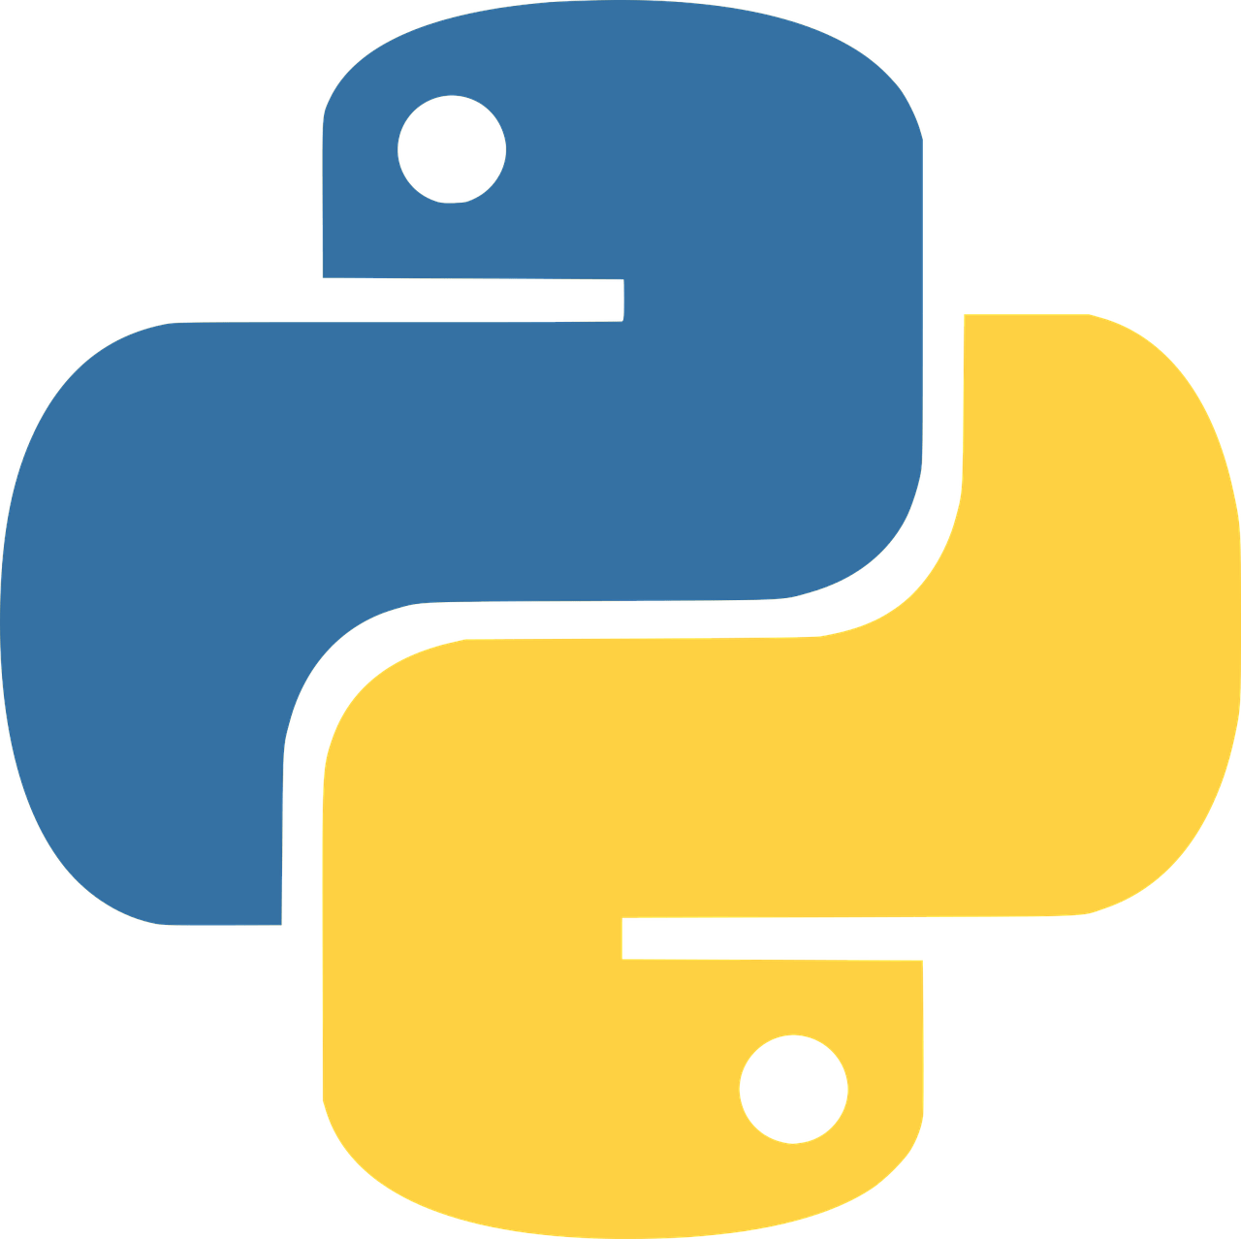
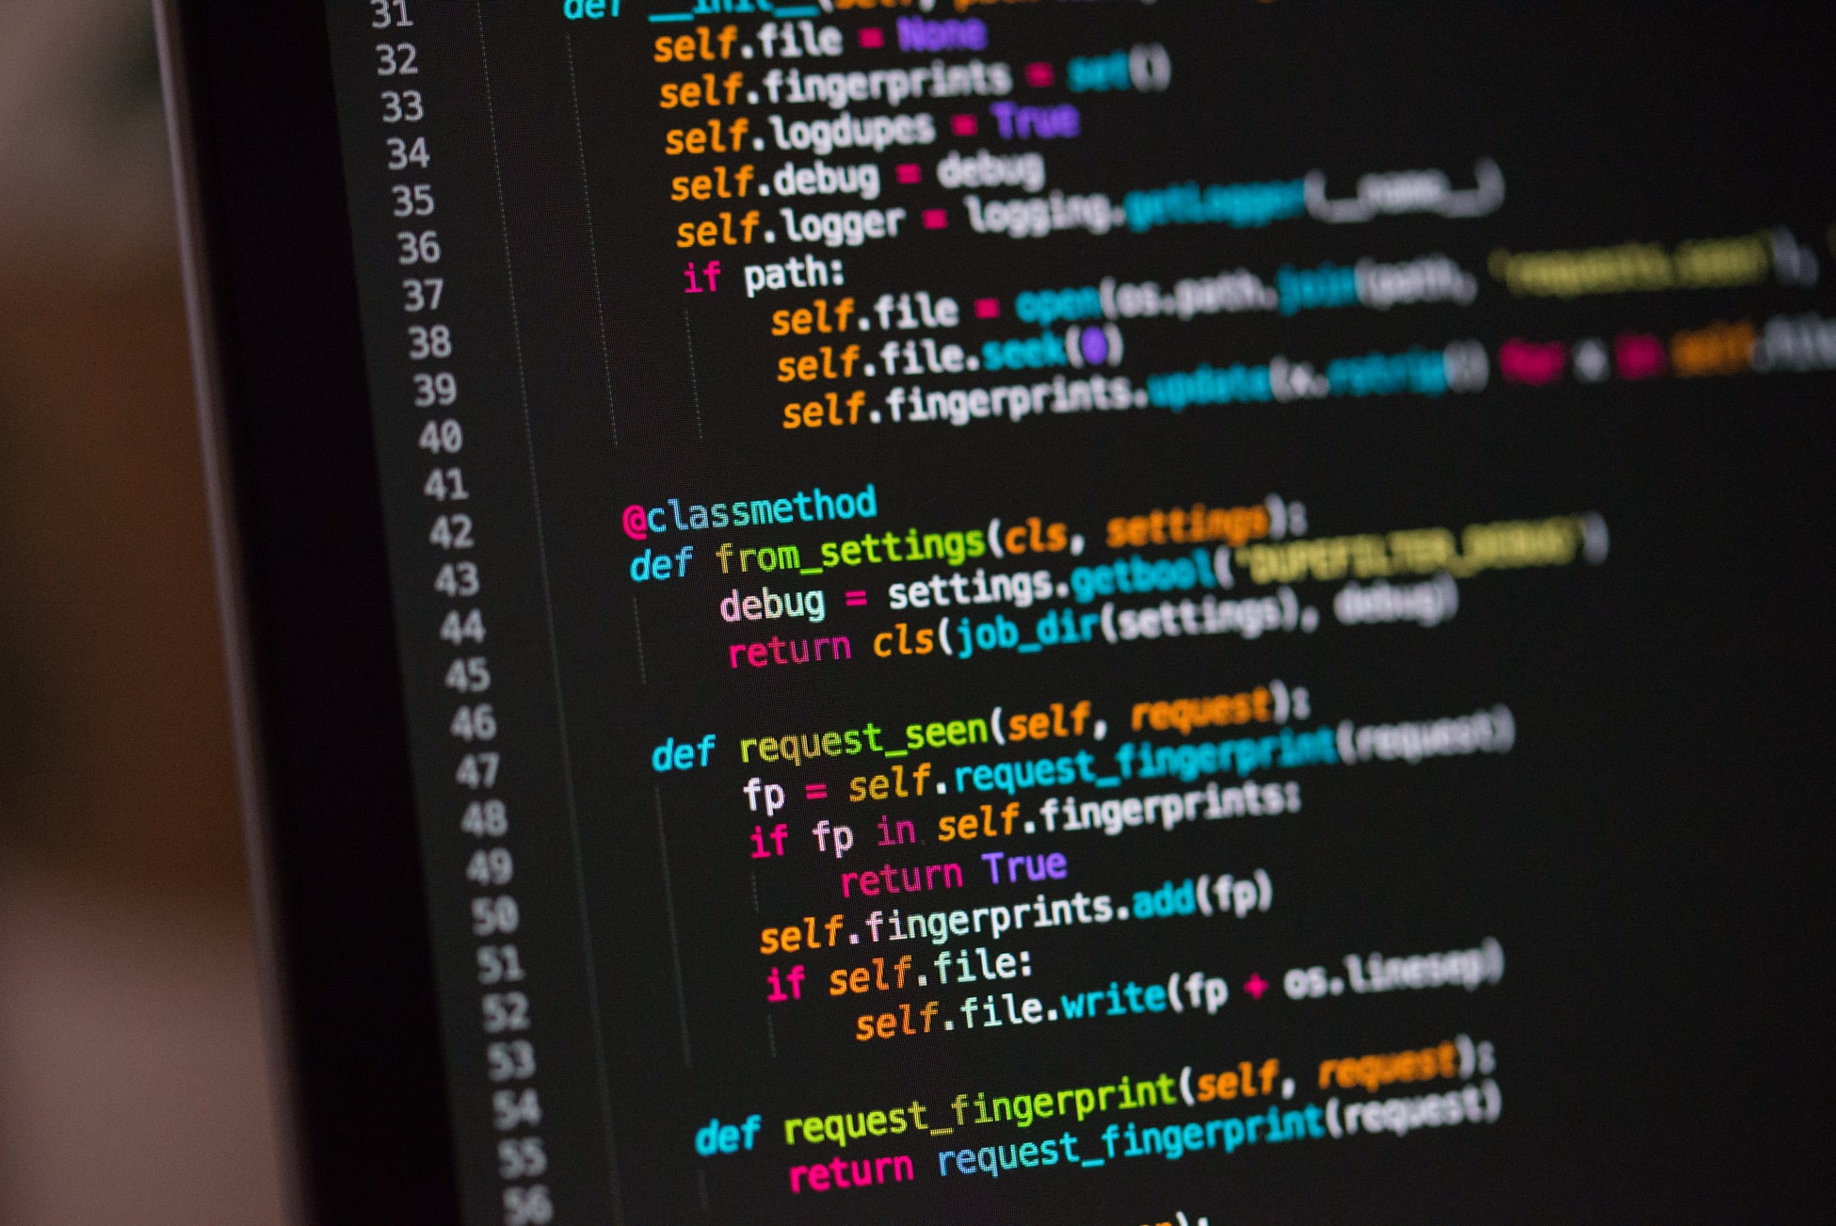
Python Programming Practice Projects
By: Bon Lee

